Slide 1
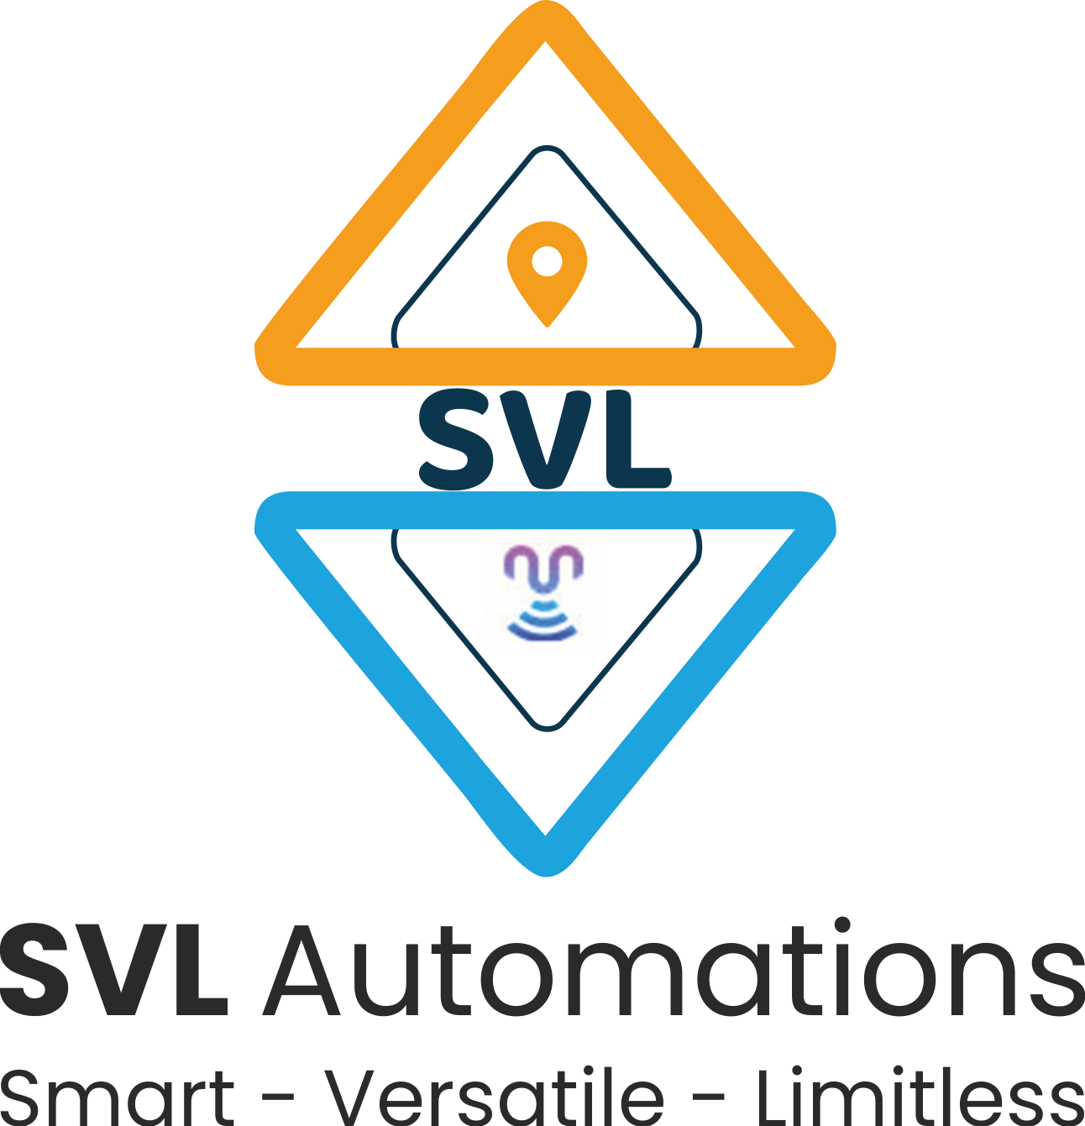
Introduction to Python Programming
Introduction to Python
Ms. Shital H. Dinde

Slide 2

Definition
Python is an interpreted general-purpose high-level programming language with easy syntax and dynamic semantics.
Monty Python's Flying Circus

Slide 3
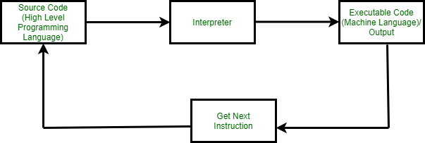
Interpreted programming language

Slide 4
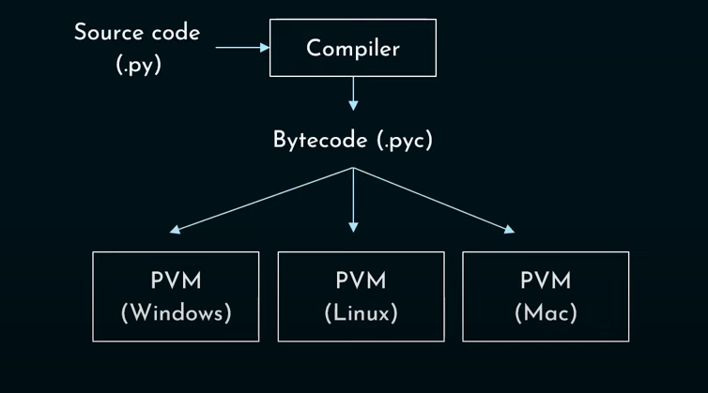
Is Python Compiled or Interpreted?
Python is both compiled and interpreted language

Slide 5

General-purpose

Slide 6
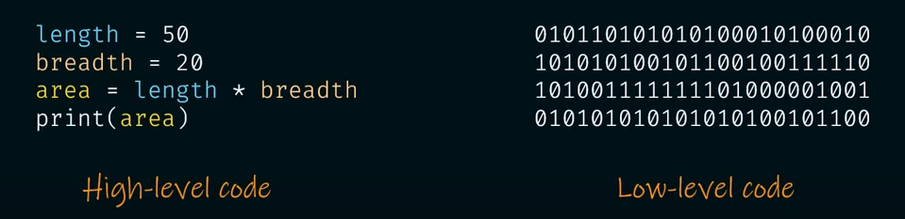
High-level programming

Slide 7
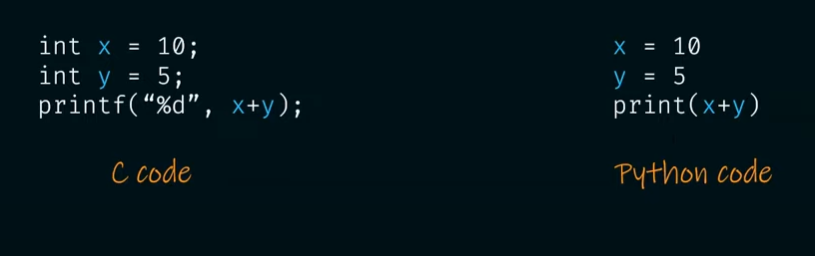
Easy syntax

Slide 8
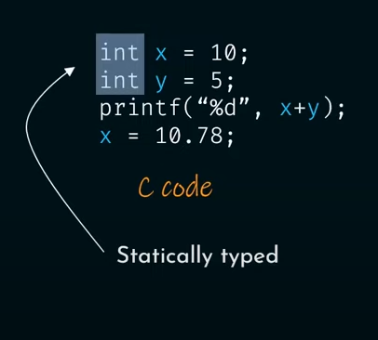
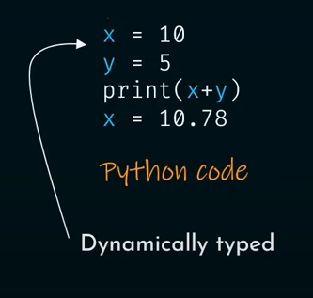
Dynamic semantics : Variables are dynamic objects

Slide 9
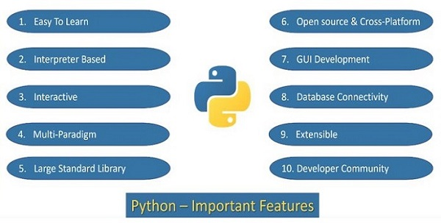
Features of Python

Slide 10
Application Areas
Data Science
Machine Learning
Web Development
Computer Vision and Image processing
Embedded Systems and IoT
Job Scheduling and Automation

Slide 11
Steps to install the python interpreter
Visit the official website : https://www.python.org/downloads/
Download the latest version of python from website
Open the executable and follow the instructions as shown

Slide 12
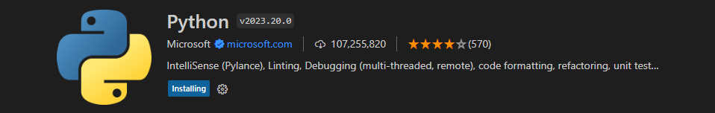
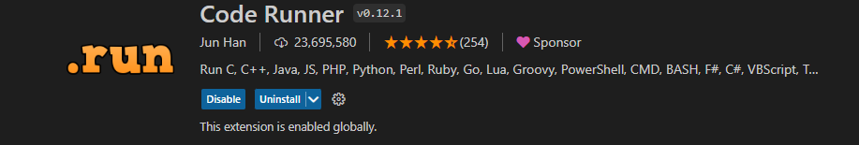
Write and execute python program in vscode
First way
Write a python program in vscode
Open terminal
Type command python filename.py
Second way
Install the python extension
Install code runner extension

Slide 13
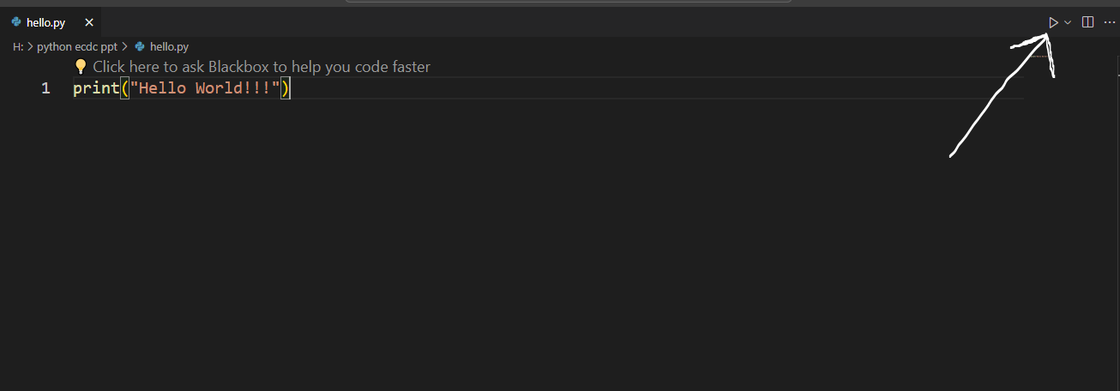
Just click on the button to execute the code

Slide 14
First Python Program
Python - Interactive Mode Programming
invoke a Python interpreter from command line by typing python at the command prompt
>>> denotes a Python Command Prompt where you can type your commands
print ("Hello, World!")
Script Mode Programming
write a simple Python program in a script which is simple text file.
print ("Hello World")
Write this code and save file with .py extension
to run this program python test.py

Slide 15
How to see the byte code
Open cmd
Open interactive shell of python
Python
>>>import py_compile
>>>py_compile.compile(‘file.py’)

Slide 16
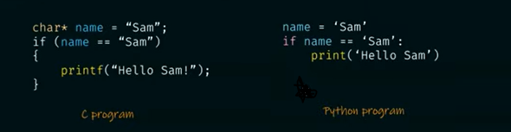
Indentation in Python
Indentation is a leading white space before any statement in python
Purpose
Improves readability
Helps in indicating block of code

Slide 17
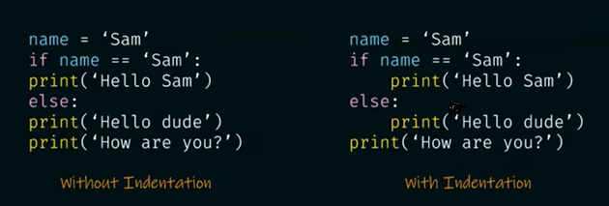
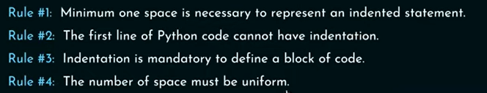
Indentation in Python
Working of indentation
Rules for Indentation

Slide 18
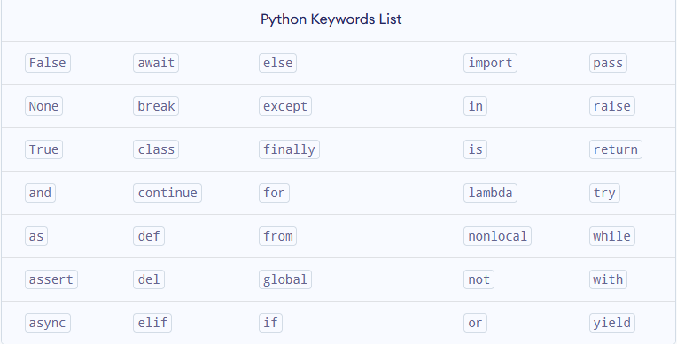
Python Keywords
Keywords are predefined, reserved words used in Python programming that have special meanings
All the keywords except True, False and None are in lowercase and they must be written as they are

Slide 19
Python Identifiers
Identifiers are the name given to variables, classes, methods, etc.
For example, language = 'Python'
Rules for Naming an Identifier
Identifiers cannot be a keyword.
Identifiers are case-sensitive.
It can have a sequence of letters and digits and _.
It's a convention to start an identifier with a letter rather _.
Whitespaces are not allowed.
We cannot use special symbols like !, @, #, $, and so on.

Slide 20
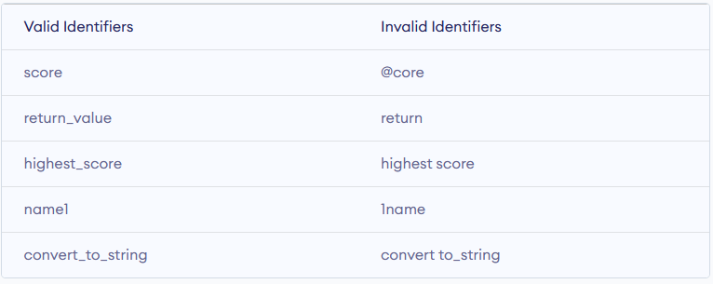

Slide 21
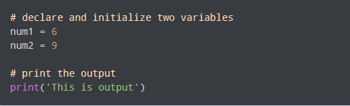
Python Comments
In computer programming, comments are hints that we use to make our code more understandable.
Comments are completely ignored by the interpreter.

Slide 22
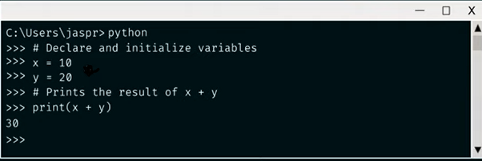
Types of Comments in Python
Single-line Comment in Python
A single-line comment starts and ends in the same line
use the # symbol to write a single-line comment

Slide 23
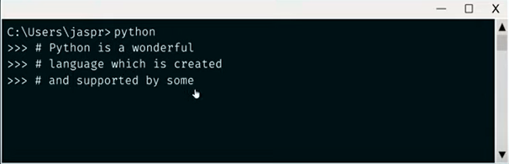
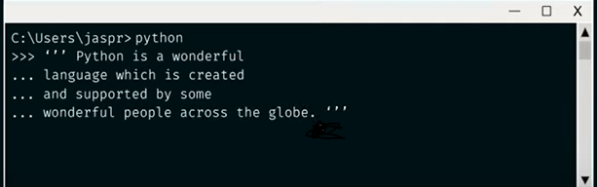
Multi-line Comment in Python
Multiple # before every line
use triple quotes, either ''' or """

Slide 24
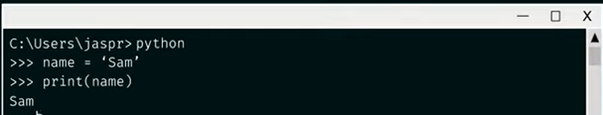
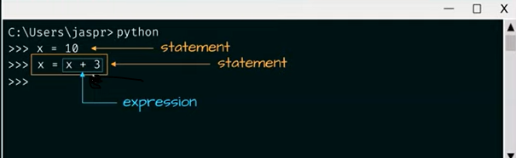
Python Statement
Statement: is a line of code that performs some action
Expression: is evaluated for a result
Notes:
Statement is an instruction for the computer to do something

Slide 25
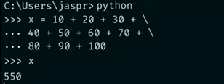
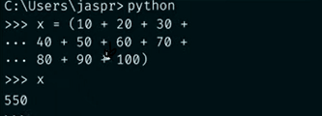
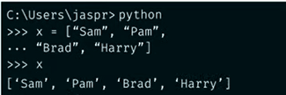
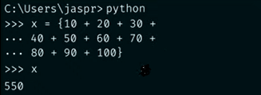
Python Statement
Multiline Statement: Statements can be extended using continuation character \, parentheses (), square bracket [], or curly brackets {}
Notes:
Statement is an instruction for the computer to do something

Slide 26
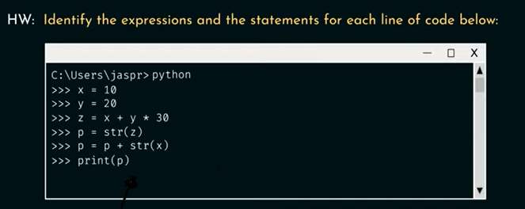
Answer the Following question

Slide 27
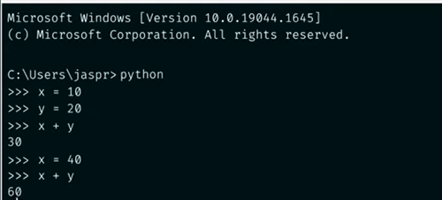
Python Variable
A variable is a name attached to a value which can be changed and is used later in the code
No need of declaration
Value of a variable can be changed
Notes:
Statement is an instruction for the computer to do something

Slide 28
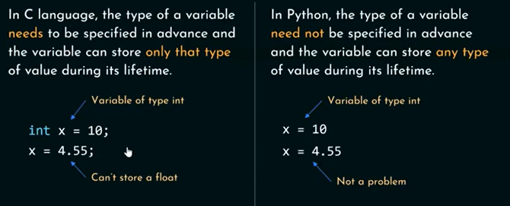
Python Variable
Notes:
Statement is an instruction for the computer to do something

Slide 29
Python Variable
Rules for Naming Python Variables
variable names should have a combination of letters in lowercase (a to z) or uppercase (A to Z) or digits (0 to 9) or an underscore (_)
Create a name that makes sense. For example, vowel makes more sense than v.
If you want to create a variable name having two words, use underscore to separate them.
Python is case-sensitive. So num and Num are different variables
Avoid using keywords like if, True, class, etc. as variable names.
Notes:
Statement is an instruction for the computer to do something

Slide 30

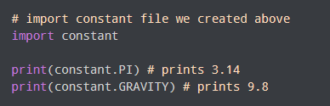
Python Constants
A constant is a special type of variable whose value cannot be changed.
Python doesn't have any formally defined constants
Constants are usually declared and assigned in a module
constant.py main.py
Notes:
Statement is an instruction for the computer to do something

Slide 31
Introduction to Python Programming
Python Data Types
Ms. Shital H. Dinde
Department of CSE
KIT’s College of Engineering (Autonomous), Kolhapur

Slide 32
What is Data Type?
Computer is a data processing device.
Computer stores the data in its memory and processes it as per the given program.
Data is a representation of facts about a certain object.
Data type represents a kind of value stored in a variable and determines what operations can be done on it.

Slide 33
Python data types
Python Data Types are used to define the type of a variable.
It defines what type of data we are going to store in a variable.
The data stored in memory can be of many types.
For example, a person's age is stored as a numeric value and his or her address is stored as alphanumeric characters.

Slide 34
Python data types
Data Types | Classes | Description
Numeric | int, float, complex | holds numeric values
String | str | holds sequence of characters
Sequence | list, tuple | holds collection of items
Mapping | dict | holds data in key-value pair form
Boolean | bool | holds either True or False
Set | set, frozeenset | hold collection of unique items

Slide 35
Numeric Data Types
Integer
Floating point number
Complex number

Slide 36

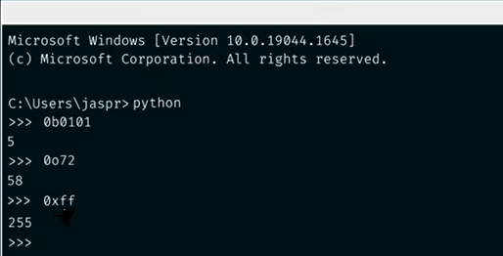
Numeric Data Types
Integer:
-1, 3, 0, 1500236 are all examples of integers
In python, there is no limit on the size of integers
Represented by int
Non Decimal integer
Binary: 0b/0B
Octal: 0o/ 0O
Hex : 0x/ 0X

Slide 37
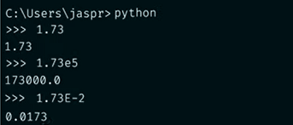
Numeric Data Types
Floating point number:
Used to represent real numbers and holds floating decimal points
It's accurate up to 15 decimal
To specify the scientific notation, e or E is added at the end of float number
Represented by float

Slide 38

Numeric Data Types
Complex number:
A complex number is made up of two parts - real and imaginary.
They are separated by '+' or '-' signs.
The imaginary part is suffixed by 'j' which is the imaginary number.
Complex number in Python is represented as x+yj, where x is the real part, and y is the imaginary part.
Represented by complex

Slide 39
Boolean Data Types
Boolean data type is used to represent any one of the two values, True or False
They correspond to integer 1 and 0 respectively.

Slide 40
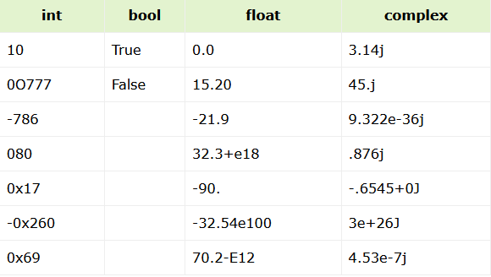
To get the type of any variable use type() function
type(123)

Slide 41
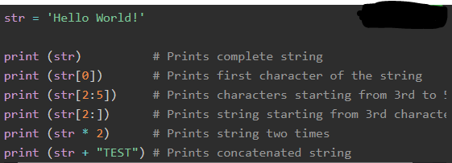
String Data Types
Python string is a sequence of one or more Unicode characters, enclosed in single, double or triple quotation marks
Python strings are immutable
A string is a non-numeric data type. Obviously, we cannot perform arithmetic operations on it. However, operations such as slicing and concatenation can be done.
Python's str class defines a number of useful methods for string processing.

Slide 42
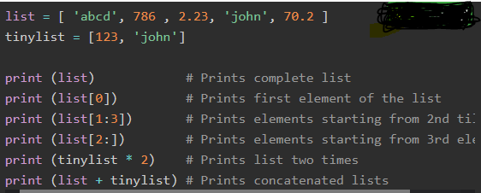
Sequence Data Types
Lists:
Python Lists are the most versatile compound data types.
List is an ordered collection of similar or different types of items separated by commas and enclosed within brackets [ ]
A list in Python is an object of list class.
Python Lists are mutable
The values stored in a Python list can be accessed using the slice operator ([ ] and [:]) with indexes starting at 0 in the beginning of the list and working their way to end -1.

Slide 43


Sequence Data Types
Tuple:
A Python tuple consists of a number of values separated by commas. Unlike lists, however, tuples are enclosed within parentheses ().
A tuple is also a sequence, hence each item in the tuple has an index referring to its position in the collection. The index starts from 0.
a tuple is an object of tuple class
To form a tuple, use of parentheses is optional. Data items separated by comma without any enclosing symbols are treated as a tuple by default.

Slide 44
Dictionary Data Type
Python dictionary is an ordered collection of items. It stores elements in key/value pairs.
The pairs are separated by comma and put inside curly brackets {}.
To establish mapping between key and value, the semicolon ':' symbol is put between the two.
A dictionary key can be almost any Python type, but are usually numbers or strings.
Values, on the other hand, can be any arbitrary Python object
Dictionary is an object of the built-in dict class.
values can be assigned and accessed using square braces ([])

Slide 45
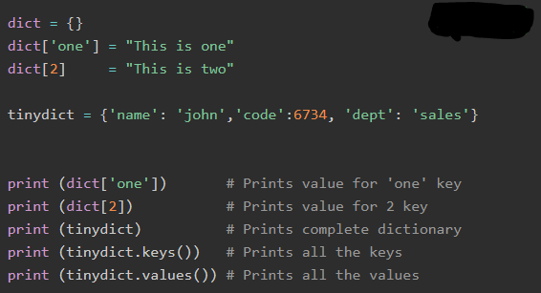
Dictionary Data Type
Dictionary is a mutable object.

Slide 46

Set Data Type
Set is a Python implementation of set as defined in Mathematics.
Set is an unordered collection of unique items.
Set is defined by values separated by commas inside braces { }
Items in the set collection may not follow the same order in which they are entered. The position of items is optimized by Python to perform operations over set as defined in mathematics.

Slide 47
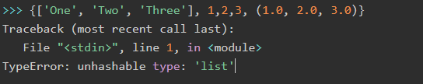
Set Data Type
A set can store only immutable objects such as number (int, float, complex or bool), string or tuple.
Even if a set doesn't allow mutable items, the set itself is mutable.
Python also has a set of operators to perform set manipulation.

Slide 48
Introduction to Python Programming
Python Operators

Slide 49
Introduction
Operator: is a special symbol that perform as operation on operands
Operand: is a value/variable to which the operation is applied

Slide 50
Different Operators in Python
Arithmetic Operators
Logical Operators
Relational / Comparison Operators
Bitwise Operators
Assignment Operators
Membership Operators
Identity Operators

Slide 51
Arithmetic Operators
List of Arithmetic Operators:
Addition and Unary plus (+)
Subtraction and Unary minus (-)
Multiplication (*)
Division (/)
Floor Division (//)
Modulus (%)
Power (**)

Slide 52
Addition and Unary Plus (+)
Unary Plus : is applied on a single operand
Ex. X=-20
y= +(X)
Addition : is applied on two operands
Ex. 10 + 20

Slide 53
Subtraction and Unary Minus(-)
Unary Minus: is applied on a single operand
Ex. x=-20
y= -(x)
Subtraction: is applied on two operands
Ex. 50 - 23

Slide 54
Multiplication (*)
It is a binary operator
Used to multiply two operands
Ex. 5 * 23

Slide 55
Division(/)
It is a binary operator
Used to divide the first operand by the second operand
Ex. 23 / 4

Slide 56
Floor Division(//)
It is a binary operator
Used to divide the first operand by the second operand but the result is always an integer value
Ex. 23 / 4

Slide 57
Modulus(%)
It is a binary operator
Performs the division but it returns the remainder as a result
Ex. 23 % 4

Slide 58
Power(**)
It is a binary operator
Calculates the first operand raised to the power second operand
Ex. 5 ** 3

Slide 59
Relational / Comparison Operators
Used to compare two operands, returns either True or False
List of Relational Operators:
Greater than (>)
Less than (<)
Equal to (==)
Greater than or Equal to (>=)
Less than or Equal to (<=)
Not Equal to (!=)

Slide 60
Greater than(>)
Returns True if left operand is greater than the right operand otherwise False
Ex. 5 > 3
Less than(<)
Returns True if left operand is less than the right operand otherwise False
Ex. 5 < 3
6.8 < 4.2

Slide 61
Equal to(==)
Returns True if left operand is equal to the right operand otherwise False
Ex. 20 == 20
Not Equal to(!=)
Returns True if left operand is not equal to the right operand otherwise False
Ex. 65 != 42

Slide 62
Greater than(>=)
Returns True if left operand is greater than or equal to the right operand otherwise False
Ex. 5 >= 3
Less than(<=)
Returns True if left operand is less than or equal to the right operand otherwise False
Ex. 5 <= 5
6.8 <= 4.2

Slide 63
Logical Operators
Used to combine conditional expressions
List of Logical Operators:
Logical AND ( and )
Logical OR ( or )
Logical NOT ( not )

Slide 64
Logical AND ( and )
Returns True if both the conditions are True otherwise it returns False
Ex. x=10
y=20
z=30
x > y and y > z

Slide 65
Logical OR ( or )
Returns True if one of the conditions is True otherwise it returns False
Ex. x=10
y=20
z=30
x > y or y > z

Slide 66
Logical NOT ( not )
Returns True if one conditional expression returns False and vice-versa
Ex. x=10
y=20
z=30
not (x > y)
not (y < z)

Slide 67
Bitwise Operators
Operates on bits (binary digits)
List of Bitwise Operators:
Bitwise AND ( &)
Bitwise OR ( | )
Bitwise NOT ( ~ )
Bitwise XOR ( ^ )
Bitwise Left Shift ( << )
Bitwise Right Shift ( >> )

Slide 68
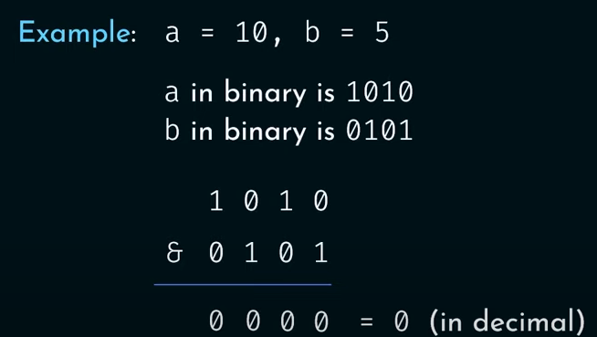
Bitwise AND ( & )
Returns 1 if both bits are 1 otherwise it returns 0

Slide 69
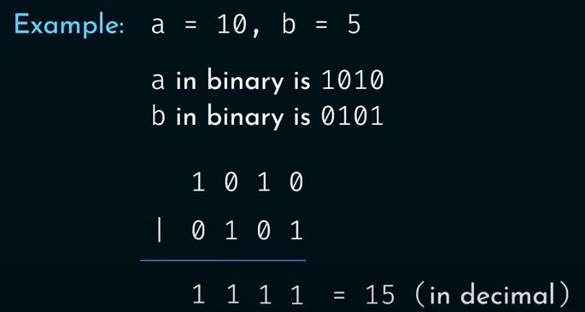
Bitwise OR ( | )
Returns 1 if one of the bits is 1 otherwise it returns 0

Slide 70
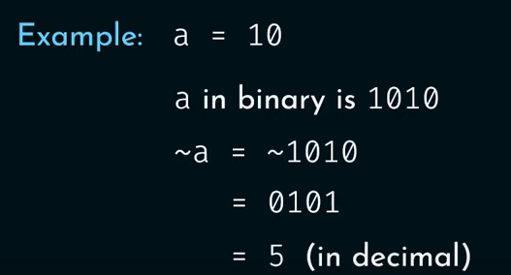
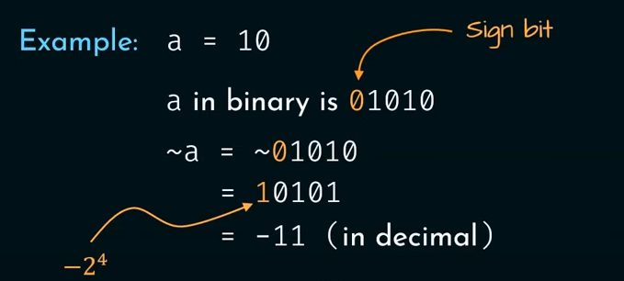
Bitwise NOT ( ~ )
Returns 1’s complement of a number

Slide 71
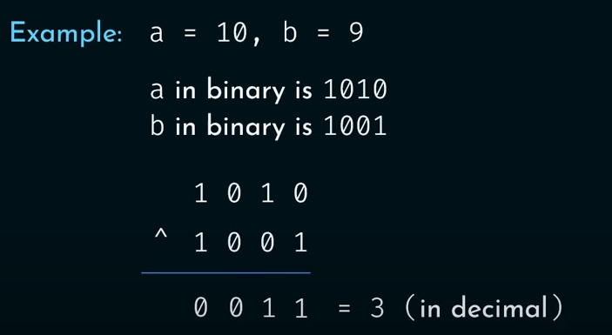
Bitwise XOR ( ^ )
Returns 0 if both the bits are equal otherwise it returns 1

Slide 72
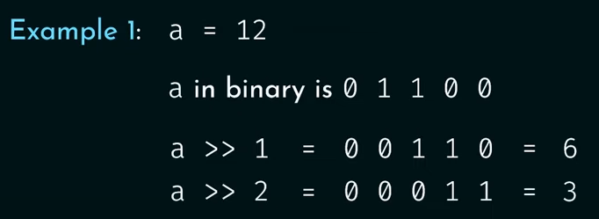
Bitwise Right Shift ( >> )
Shifts the bits of binary number to the right
As a consequence it divides the number by 2^{n}

Slide 73
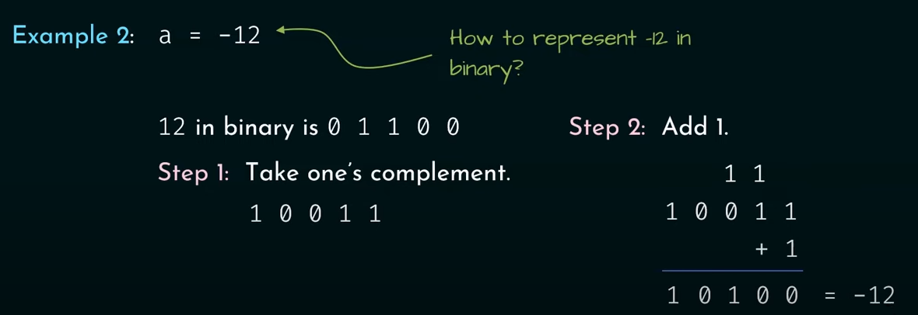
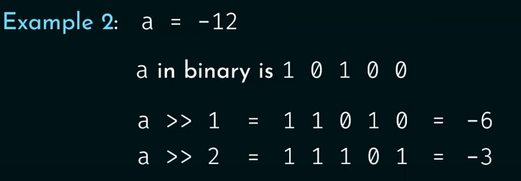
Bitwise Right Shift ( >> )

Slide 74
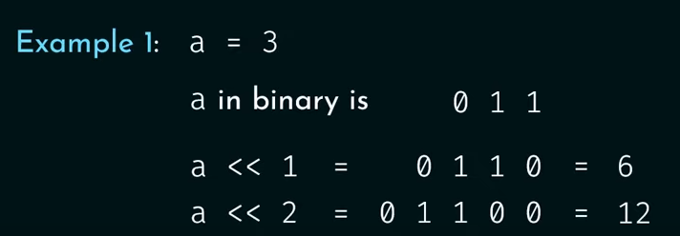
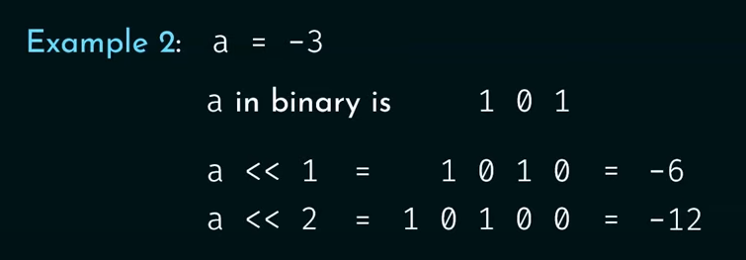
Bitwise Left Shift ( << )
Shifts the bits of binary number to the right
As a consequence it multiplies the number by 2^{n}

Slide 75

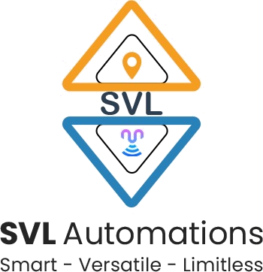
Questions?

Slide 76

8888 763 563
88 5335 4141
https://svlautomations.in
https://svltrainings.in

